Slide 1
Ensemble Learning

Slide 2
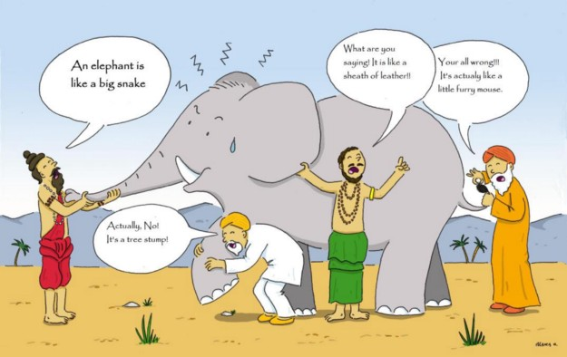
Parable of blind men and elephant
All of the blind men had their own description of the elephant. Even though each of the description was true, it would have been better to come together and discuss their understanding before coming to final conclusion.
This story perfectly describes the Ensemble learning method.

Slide 3
ENSEMBLE LEARNING
Ensemble methods combine several decision trees classifiers to produce better predictive performance than a single decision tree classifier.
The main principle behind the ensemble model is that a group of weak learners come together to form a strong learner, thus increasing the accuracy of the model.
When we try to predict the target variable using any machine learning technique, the main causes of difference in actual and predicted values are noise, variance, and bias.
Ensemble helps to reduce these factors

Slide 4
ENSEMBLE LEARNING
Using techniques like Bagging and Boosting helps to decrease the variance and increased the robustness of the model.
Combinations of multiple classifiers decrease variance, especially in the case of unstable classifiers, and may produce a more reliable classification than a single classifier.

Slide 5
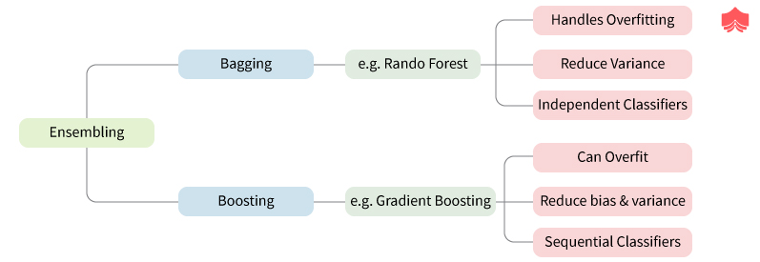
ENSEMBLE LEARNING

Slide 6
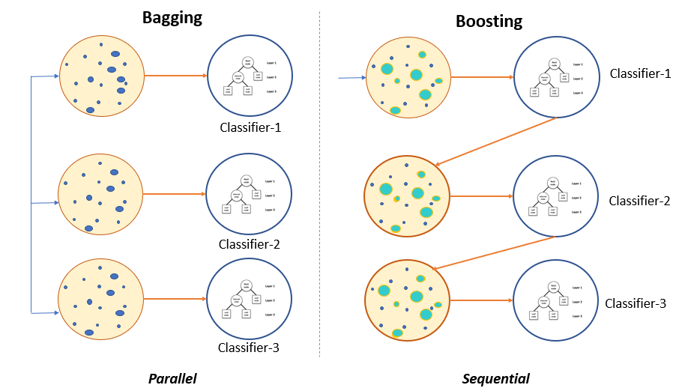
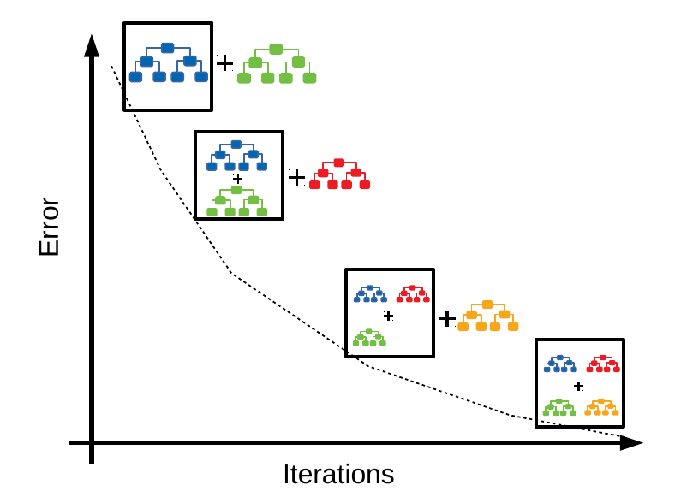
What are Ensemble Techniques ?
Ensembles are built on the idea that a collection of weak predictors, when combined together, give a final prediction which performs much better than the individual ones

Slide 7
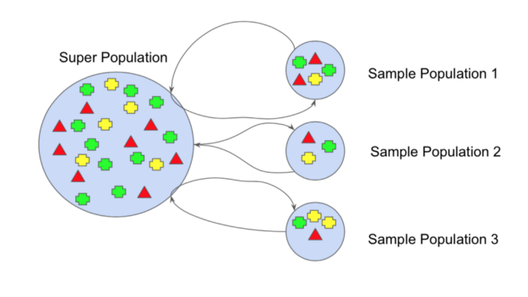
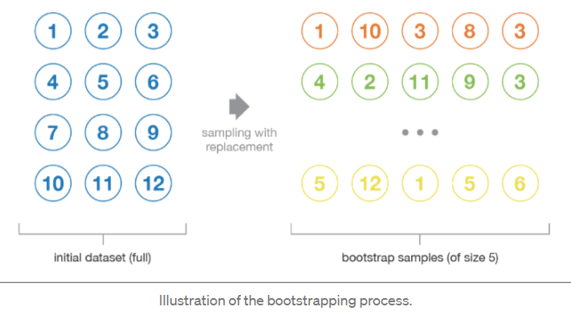
Bootstrapping
Bootstrap refers to random sampling with replacement.
Bootstrap allows us to better understand the bias and the variance with the dataset.
Bootstrap involves random sampling of small subset of data from the dataset.
This subset can be replace.
The selection of all the example in the dataset has equal probability.
This method can help to better understand the mean and standard deviation from the dataset.

Slide 8
Bootstrapping
We can improve the estimate of our mean using the bootstrap procedure:
Create many (e.g. m) random sub-samples of our dataset with replacement
(meaning we can select the same value multiple times).
Calculate the mean of each sub-sample.
Calculate the average of all of our collected means and use that as our estimated mean for the data.
For example, let’s say we used 3 resamples and got the mean values 2.5, 3.3 and 4.7.
Taking the average of these we could take the estimated mean of the data to be 3.5.

Slide 9
BAGGING
Bootstrap Aggregation (or Bagging for short), is a simple and very powerful ensemble method
Bagging is the application of the Bootstrap procedure to a high-variance machine learning algorithm, typically decision trees
Considers homogeneous weak learners, learns them independently from each other in parallel and combines them following some kind of deterministic averaging process

Slide 10
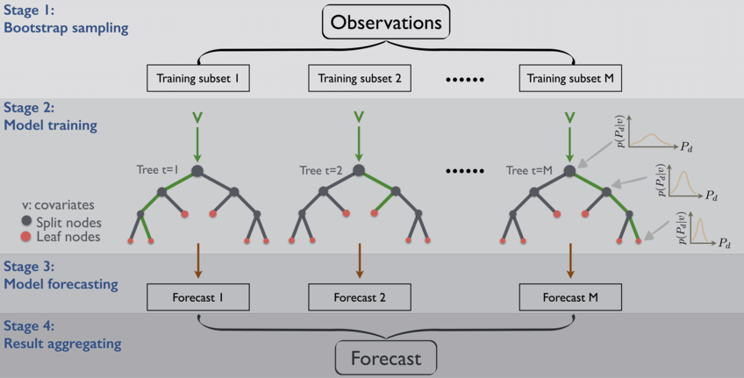
Bagging

Slide 11
BAGGING
Bagging is the application of the Bootstrap procedure to a high-variance machine learning algorithm, typically decision trees
Suppose there are N observations and M features. A sample from observation is selected randomly with replacement(Bootstrapping)
A subset of features are selected to create a model with sample of observations and subset of features
Feature from the subset is selected which gives the best split on the training data.
This is repeated to create many models and every model is trained in parallel
Prediction is given based on the aggregation of predictions from all the models.

Slide 12
Bagging
When bagging with decision trees, we are less concerned about individual trees overfitting the training data.
For this reason and for efficiency, the individual decision trees are grown deep (e.g. few training samples at each leaf-node of the tree) and the trees are not pruned.
These trees will have both high variance and low bias.
These are important characterize of sub-models when combining predictions using bagging.
The only parameters when bagging decision trees is the number of samples and hence the number of trees to include.
This can be chosen by increasing the number of trees on run after run until the accuracy begins to stop showing improvement

Slide 13
Random Forest Classifier
Training Data
M features
N examples
Notes:
As the classifier of choice we adopt Random Forest Classifier, due to its robustness to heterogenous and noisy feature.
Random Forest is an ensembe classifier. Briefly, given N data and M features, bootsrap samples are created from the traning data

Slide 14
Random Forest Classifier
Create bootstrap samples
from the training data
M features
N examples
....…

Slide 15
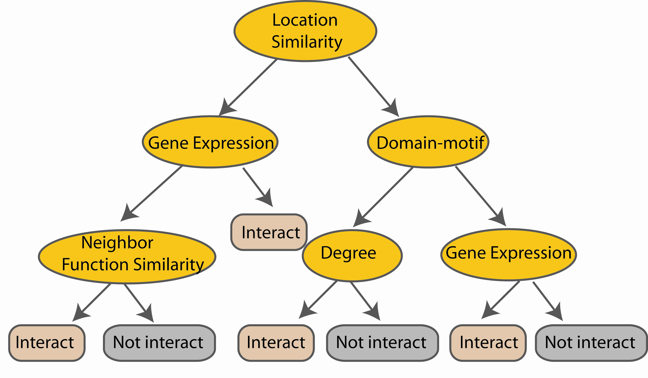
Random Forest Classifier
Construct a decision tree
M features
N examples
....…
Notes:
From eachd descision tree .. In spliting the nodes, the Gini Gain is employed

Slide 16

Random Forest Classifier
At each node in choosing the split feature
choose only among m<M features
M features
N examples
....…
Notes:
Different from the regular decision trees in random forest, when the splitting feature is chosen from only a subset of allf eatures.
The robostness of the classifier arises from
bootsraping of the training data and the random selection of features, the the random choose of features.

Slide 17

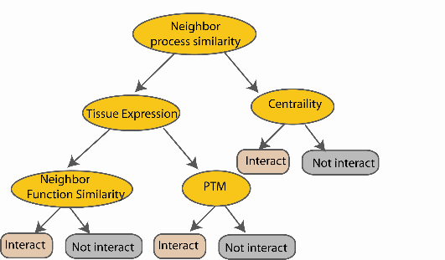
Random Forest Classifier
Create decision tree
from each bootstrap sample
M features
N examples
....…
....…

Slide 18
Random Forest Classifier
M features
N examples
Take the majority vote
....…
....…
Notes:
Finally the given an input data the decision is made as follows given an input data,

Slide 19
Random Forests Algorithm
For b = 1 to B:
(a) Draw a bootstrap sample Z∗ of size N from the training data.
(b) Grow a random-forest tree to the bootstrapped data, by recursively repeating the following steps for each terminal node of the tree, until the minimum node size n_{min} is reached.
i. Select m variables at random from the p variables.
ii. Pick the best variable/split-point among the m.
iii. Split the node into two daughter nodes.
Output the ensemble of trees.
To make a prediction at a new point x we do:
For regression: average the results
For classification: majority vote

Slide 20
Random Forests Tuning
The inventors make the following recommendations:
For classification, the default value for m is √p and the minimum node size is one.
For regression, the default value for m is p/3 and the minimum node size is five.
In practice the best values for these parameters will depend on the problem, and they should be treated as tuning parameters.

Slide 21
References
https://www.knowledgehut.com/blog/data-science/bagging-and-random-forest-in-machine-learning
https://machinelearningmastery.com/bagging-and-random-forest-ensemble-algorithms-for-machine-learning/
https://towardsdatascience.com/decision-tree-ensembles-bagging-and-boosting-266a8ba60fd9

